Slide 1
Images in Binary

Slide 2
Bitmap images
Binary can be used to create bitmap images.
Bitmap images are made up of a grid (or map) of pixels.
Each pixel is assigned a binary code to represent it’s colour.
Here 1 means black and 0 means white.
0 | 0 | 1 | 1 | 1 | 1 | 0 | 0
0 | 1 | 0 | 0 | 0 | 0 | 1 | 0
1 | 0 | 0 | 0 | 0 | 0 | 0 | 1
1 | 0 | 1 | 0 | 0 | 1 | 0 | 1
1 | 0 | 1 | 0 | 0 | 1 | 0 | 1
1 | 0 | 0 | 0 | 0 | 0 | 0 | 1
1 | 0 | 1 | 0 | 0 | 1 | 0 | 1
1 | 0 | 0 | 1 | 1 | 0 | 0 | 1
0 | 1 | 0 | 0 | 0 | 0 | 1 | 0
0 | 0 | 1 | 1 | 1 | 1 | 0 | 0

Slide 3
Bitmap images
Binary can be used to create bitmap images.
Bitmap images are made up of a grid (or map) of pixels.
Each pixel is assigned a binary code to represent it’s colour.
Here 1 means black and 0 means white.
0 | 0 | 1 | 1 | 1 | 1 | 0 | 0
0 | 1 | 0 | 0 | 0 | 0 | 1 | 0
1 | 0 | 0 | 0 | 0 | 0 | 0 | 1
1 | 0 | 1 | 0 | 0 | 1 | 0 | 1
1 | 0 | 1 | 0 | 0 | 1 | 0 | 1
1 | 0 | 0 | 0 | 0 | 0 | 0 | 1
1 | 0 | 1 | 0 | 0 | 1 | 0 | 1
1 | 0 | 0 | 1 | 1 | 0 | 0 | 1
0 | 1 | 0 | 0 | 0 | 0 | 1 | 0
0 | 0 | 1 | 1 | 1 | 1 | 0 | 0
File size = 10 bytes

Slide 4
File size
The more bits you use per pixel the more colours you can have.
1 bit = two colours because there are two combinations (0,1).
2 bits = four colours because there are four combinations. (11,00,10,01).
But the more pixels you use the larger the file size.
11 | 11 | 11 | 11 | 11 | 11 | 11 | 11
11 | 11 | 11 | 11 | 11 | 11 | 11 | 11
11 | 11 | 11 | 10 | 11 | 11 | 11 | 11
11 | 11 | 10 | 10 | 10 | 11 | 11 | 11
11 | 11 | 00 | 00 | 00 | 11 | 11 | 11
11 | 11 | 00 | 00 | 00 | 11 | 11 | 11
11 | 11 | 00 | 00 | 00 | 11 | 11 | 11
11 | 10 | 00 | 10 | 00 | 10 | 11 | 11
11 | 11 | 01 | 01 | 01 | 11 | 11 | 11
11 | 11 | 11 | 01 | 11 | 11 | 11 | 11
File size = 20 bytes
8 bits = 1 byte
File size = 20 bytes

Slide 5
File size
11 | 11 | 11 | 11 | 11 | 11 | 11 | 11
11 | 11 | 11 | 11 | 11 | 11 | 11 | 11
11 | 11 | 11 | 10 | 11 | 11 | 11 | 11
11 | 11 | 10 | 10 | 10 | 11 | 11 | 11
11 | 11 | 00 | 00 | 00 | 11 | 11 | 11
11 | 11 | 00 | 00 | 00 | 11 | 11 | 11
11 | 11 | 00 | 00 | 00 | 11 | 11 | 11
11 | 10 | 00 | 10 | 00 | 10 | 11 | 11
11 | 11 | 01 | 01 | 01 | 11 | 11 | 11
11 | 11 | 11 | 01 | 11 | 11 | 11 | 11
10 squares down
8 squares across
2 bits in each square
10 x 8 = 80 - we now know we have 80 squares.
80 x 2 = 160 – we did this because there are 2 bits in each square
160/8 = 20 – we did this because we need to know the size in bytes.
20bytes
8 bits = 1 byte
File size = 20 bytes

Slide 6
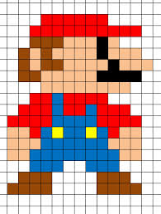
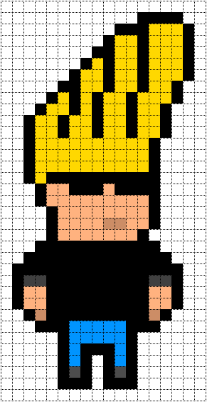
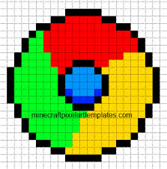
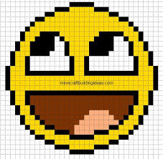
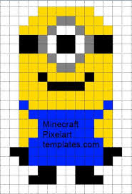
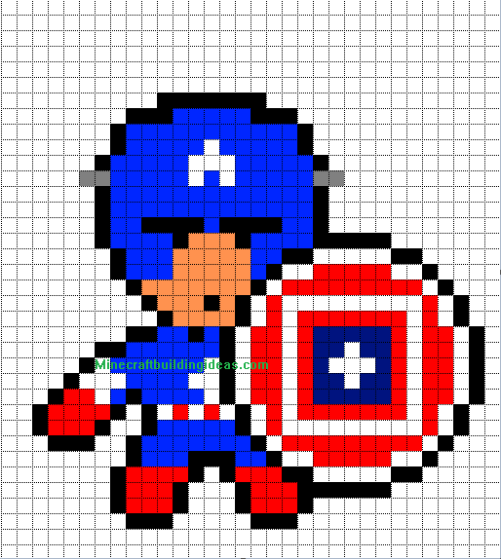
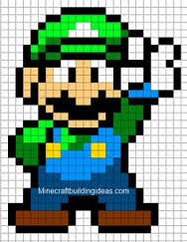
Pixel art

Slide 7
Challenge 1:
Use the spreadsheet in activity 1 to create some pixel art using binary.

Slide 8
Challenge 2:
Use the spreadsheet in activity 2 to help you calculate the file size of an image.

Slide 9
Unit 10: Electronics
Plenary
0 | 0 | 1 | 1 | 1 | 1 | 0 | 0
0 | 1 | 0 | 0 | 0 | 0 | 1 | 0
1 | 0 | 0 | 0 | 0 | 0 | 0 | 1
1 | 0 | 1 | 0 | 0 | 1 | 0 | 1
1 | 0 | 1 | 0 | 0 | 1 | 0 | 1
1 | 0 | 0 | 0 | 0 | 0 | 0 | 1
1 | 0 | 1 | 0 | 0 | 1 | 0 | 1
1 | 0 | 0 | 1 | 1 | 0 | 0 | 1
0 | 1 | 0 | 0 | 0 | 0 | 1 | 0
0 | 0 | 1 | 1 | 1 | 1 | 0 | 0
Notes:
What is the file size of this image in bytes? 10 bytes!

